Slide 1

Autonomy, Self-Determination, and Strengths-Based Approaches to All
Learners with Disabilities: A Bridge for 21st Century Transitions
Michael L. Wehmeyer, Ph.D.
Ross and Marianna Beach Distinguished Professor in Special Education
Chair, Department of Special Education
Senior Scientist and Director, Beach Center on Disability
University of Kansas

Slide 2
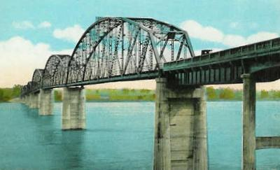

A Bridge to Where?

Slide 3

A Bridge to a Bright Future…

Slide 4
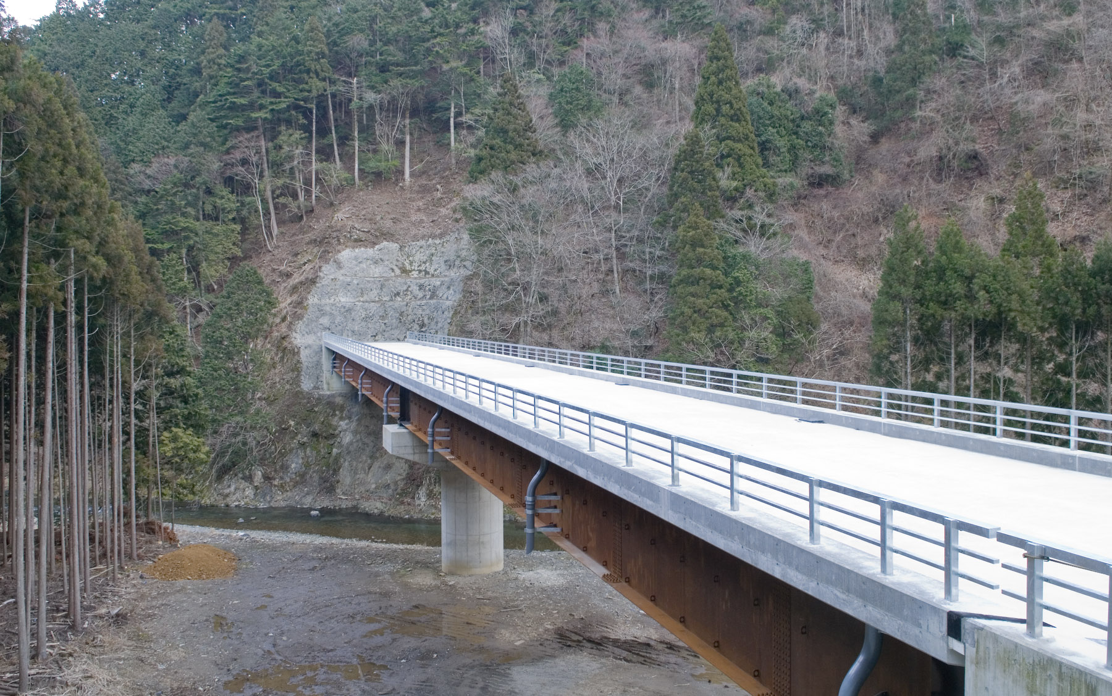
…or a Bridge to Nowhere?

Slide 5




When I Grow Up, I Want…
…to file all day.
…to be replaced on a whim.
…to be underappreciated.
…to paid less for doing the same job.
Notes:
Play off definition of confusing, wonderful, frightening to Bridge theme

Slide 6
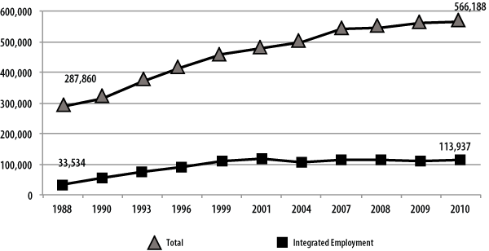
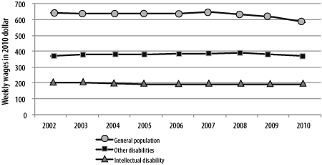
This Matters
Butterworth, J., Smith, F., A., Hall, A.C., Migliore, A., Winsor, J., Domin, D., Timmons, J.C. (2012). StateData: The national report on employment services and outcomes. Boston, MA: University of Massachusetts Boston, Institute for Community Inclusion.

Slide 7
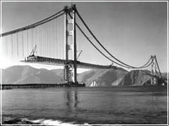
Building the Bridge: Changing How we Think About Disability

Slide 8

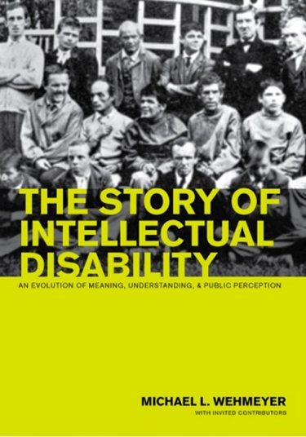
Historic Understandings of Disability
Historically, disability was understood within a model that was an extension of the medical model, which conceived health as an interiorized state and health problems as an individual pathology; a problem within the person.
Within such a model, disability was understood as a characteristic of the person; as residing with the person.
  The person was seen as broken, diseased, pathological, atypical, or aberrant; as outside the norm.
  Perhaps unavoidably, people with disabilities were, consequently, associated with numerous negative stereotypes.

Slide 9

Emergence of Strengths-Based Models of Disability
1980- International Classification of Impairments, Disabilities, and Handicaps (ICIDH)
2001- International Classification of Functioning, Disability and Health (ICF)

Slide 10

Changing Expectations: Changing Understanding
Disability
Personal
Incompetence

Slide 11

Changing Expectations: Changing Understanding
Environment
Personal
Competence

Slide 12
Changing Expectations: Changing Understanding
Disability
Environment
Personal
Competence

Slide 13
Implications of Strengths-based Approaches to Disability
Emphasizes abilities
Part of, not apart from, typical human functioning
Focus on environment/context, not fixing individual
Focus on participation
Emphasizes supports, not programs

Slide 14
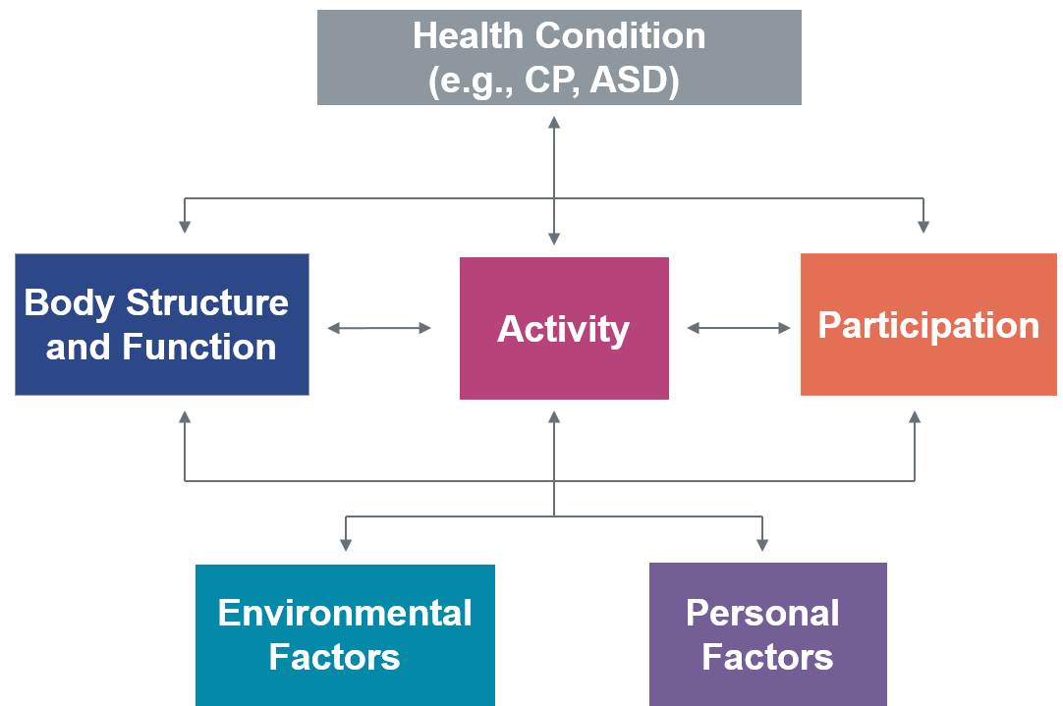
Participation
ICF
  Activity: Execution of a task or action by an individual.
  Participation: Involvement in a life situation.
  Participation is a person’s self-determined involvement in a pattern of life (i.e., roles, life situations, and activities).
    Self-determined involvement, as such, refers to a person’s active, intentional, volitional, goal-directed, sustained, and connected engagement in a pattern of life.
    Pattern of life represents the roles, life situations, and activities that comprise daily life. In general, patterns of life represent socially defined sets of behavior that support participation.

Slide 15

Supports are Resources and Strategies that…
promote the interests and causes of individuals with or without disabilities;
enable them to access opportunities, information, and relationships inherent within integrated work and living environments;
result in enhanced interdependence, productivity, community inclusion, life satisfaction, and human functioning.
  In other words, anything that enables a person to live a self-determined life.
Specialized Services
Generic Services
Nonpaid Supports
Family & Friends
Person

Slide 16
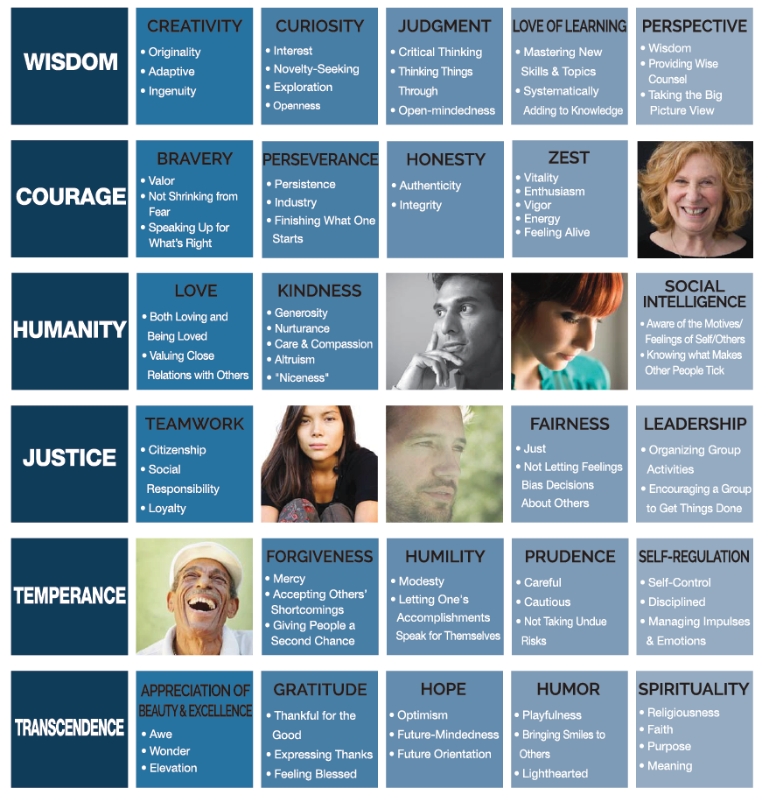

VIA Classification of Strengths
© Copyright 2011-2015 VIA INSTITUTE ON CHARACTER. ALL RIGHTS RESERVED.

Slide 17
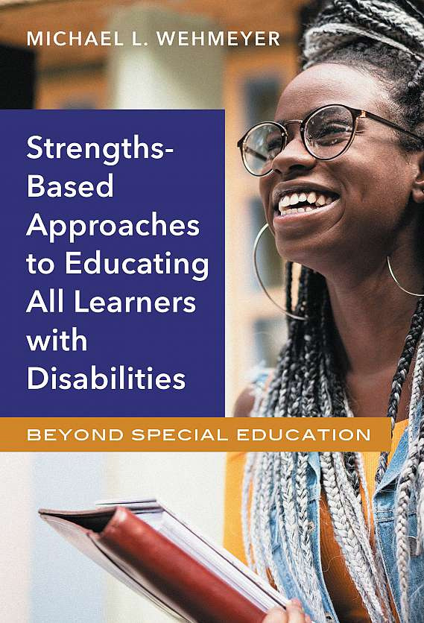
Implications for the Education of All Learners
Universal Design for Learning
Technology Supports
  Assistive technology and accommodations.
  Electronic and information technology.
Schoolwide Applications
  Positive Behavior Interventions and Supports
  Multitiered Systems of Supports
Personalizable Education
A Focus on Self-Determination and Self-Determined Learning
Active Student Involvement in Educational Planning

Slide 18
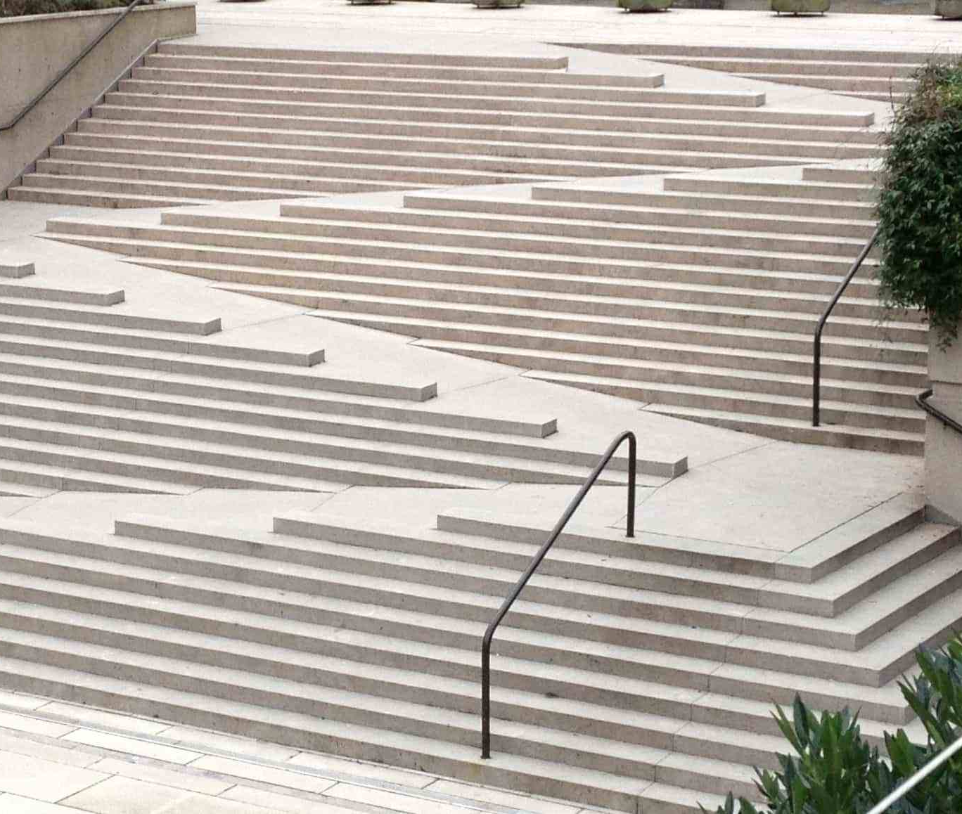
Universal Design
Universal design is the design of products and environments to be usable by all people, to the greatest extent possible, without the need for adaptation or specialized design.
Universally designed environments and products are designed to be used by all people, without further modifications.
Notes:
More icons available at:

Slide 19
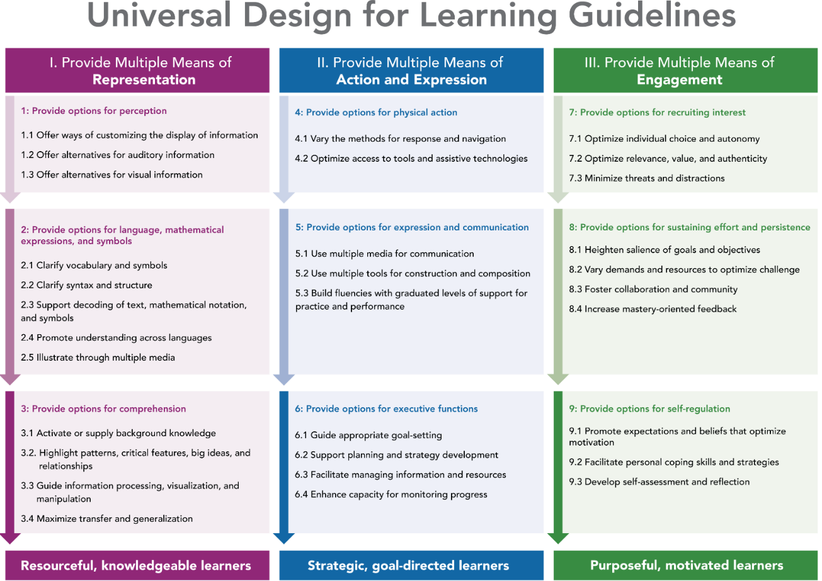
Universal Design for Learning
Universal Design for Learning
“the design of instructional materials and activities that allows the learning goals to be achievable by individuals with wide differences in their abilities to see, hear, speak, move, read, write, understand English, attend, organize, engage, and remember” (Orkwis & McLane, 1998).
http://udlguidelines.cast.org/
Notes:
More icons available at:

Slide 20

Role of Technology
Digital talking books
Smartphones, iPads, & Tablet PCs
Cloud-based apps
3D Printing
The Internet of Everything

Slide 21

A 21st Century Education
“In the modern ‘flat world,’ the ‘Three Rs’ [reading, writing, arithmetic] simply aren’t enough. If today’s students want to compete in this global society, they must also be proficient communicators, creators, critical thinkers, and collaborators (the ‘Four Cs’)” (National Education Association, 2016, p. 5).
Deep learning “increases student engagement in the learning through personalization and ownership” and “connects students to the ‘real world,’ which is often more reflective of their own reality and cultural identity” (Fullan et al., 2018, p. 9).
“Today, in the new age, a majority of traditional routine tasks that required a homogenous set of skills and knowledge are now performed by machines, and human needs have shifted from basic needs to more psychological, aesthetic and intellectual needs. Thus, the full spectrum of human talents has become economically valuable” (Zhao, 2018, p. 57).
Fullan, M., Quinn, J., & McEachen, J. (2018). Deep learning: Engage the world change the world. Thousand Oaks, CA: Corwin.
National Education Association. (2016). Preparing 21st century students for a global society: An educator’s guide to the “four Cs.” Washington, DC. Author.
Zhao, Y. (2018). Reach for greatness: Personalizable education for all children. Thousand Oaks, CA: Corwin.

Slide 22
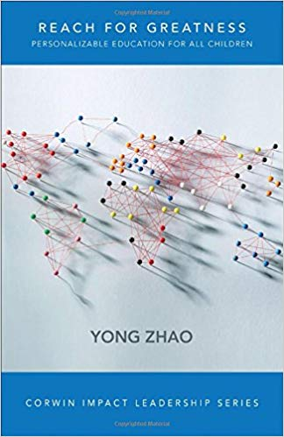
Personalizable Education
The educational status quo is based upon two basic, but flawed assumptions: (1) “there is a set of skills and knowledge everyone must have in order to live a successful life in the world,” and (2) “all children are capable of and interested in acquiring the skills and knowledge at a similar pace” (Zhao, 2018, p. 8).
Instead:
Changes in society always redefine the value of knowledge and skills. Changes brought about by technology have made traditionally valued skills and knowledge obsolete, requiring the need to consider new human qualities.
Understandings of human nature and learning suggest that human beings are differently talented, have different desires and interests, and have different experiences that interact with their natural talents and interests to give each person a unique profile of abilities and desires, stronger in some areas and weaker in others.
In a world in which technology has and will continue to replace humans in routine tasks, we need human beings to be unique, creative, and entrepreneurial and an education system that helps every student become uniquely creative and entrepreneurial. (p. 9)

Slide 23

Personalizable Education
We need to rethink individualization: “the education system rarely cares about children’s individual passions or talents” and emphasizes primarily the “talents” of being a good student, following rules, doing homework, getting good grades, and passing tests (Zhao, 2018, p. 17).
Personalizable Education
Agency: “for students to explore, identify and enhance their strengths and follow their passions, they must become owners of their own learning . . . They must have agency in designing their own learning” (p. 58).
Shared Ownership: emphasizes that students and adults (teachers, administrators, cafeteria workers, para-educators, etc.) are co-owners of what happens in the school.
Flexibility: [in] all aspects of the school: leadership, timetable, curriculum, facilities, students, and staffing.” Flexibility is first and foremost a mindset that “believes in the value of change and that plans, no matter how carefully thought out, will always have unexpected disruptions and/or outcomes that require change” (p. 64).
Value Creation: “guiding students in turning their passions and strengths into something valuable,” which makes learning meaningful and gives it purpose (p. 65).

Slide 24
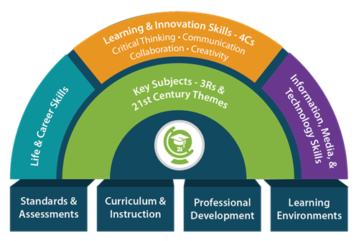
A 21st Century Transition
“What 21st-century learners (and workers) need are … flexibility and adaptability, initiative and self-direction, social and cross-cultural relationships, and productivity and accountability” (http://www.p21.org/about-us/p21-framework/266-life-and-career-skills).
Young people entering the work world today will occupy at least 10 (and probably many more) jobs over their lifetime. “[T]he new job market … calls for viewing career not as a lifetime commitment to one employer, but as a recurrent selling of services and skills to a series of employers who need projects completed” (Savickas, 2012, p. 13).
Savickas, M. L. (2012). Life design: A paradigm for career intervention in the 21st century. Journal of Counseling & Development, 90, 13–19.

Slide 25

A 21st Century Transition
Career construction is the idea that: “Careers do not unfold; they are constructed as individuals make choices that express their self-concepts and substantiate their goals in the social reality of work role” (Savickas, 2005, p. 43).
The Life Design approach “is framed as a lifelong self-construction process that aims to promote skills and competences in overall life planning” (Wehmeyer et al., in press).
Life-designing emphasizes enabling young people to become experts in ‘constructing’ their own career paths, taking on transitions, addressing threats and opportunities, and designing a better life (Nota & Rossier, 2009).
http://www.careerconstructioninstitute.org/
Nota, L., & Rossier, J. (2014). Handbook of the life design paradigm: From practice to theory, from theory to practice. Gottingen: Hogrefe.
Savickas, M. L. (2005). The theory and practice of career construction. In S. D. Brown & R. W. Lent (Eds.), Career development and counseling: Putting theory and research to work (pp. 42–60). Hoboken, NJ: Wiley.

Slide 26
Implications for Transition Services
From Career Development to Life Design
  “Theoretical models are needed that emphasize human flexibility, adaptability, and life-long learning...” (Savickas et al, 2009, p. 240).
  Life-designing emphasizes enabling young people to become experts in ‘constructing’ their own career paths, taking on transitions, addressing threats and opportunities, and designing a better life (Nota & Rossier, 2009).
From Special Education to Self-Determined Education
Savickas, M.L., Nota, L., Rossier, J., Dauwalder, J-P., Duarte, M.E., Guichard, J. … van Vianen, A.E.M. (2009). Life designing: A paradigm for career construction in the 21st century. Journal of Vocational Behavior, 75(3), 239-250.
Nota, L., & Rossier, J. (2014). Handbook of the life design paradigm: From practice to theory, from theory to practice. Gottingen: Hogrefe

Slide 27

Implications for Transition Educators
Presume competence.
Promote self-determination.
Involve young people in planning for their future.
Emphasize goal setting and problem solving.
Consider the role of hope, optimism, resilience, coping, and so forth in the lives of young people with disabilities.

Slide 28
Building the Bridge:
Promoting Self-Determination

Slide 29

Self-Determination and Determinism
Self-Determination and Determinism
The philosophical doctrine of determinism posits that actions are caused by events or natural laws that precede or are antecedent to the occurrence of the action. Behavior, then, is governed by these other events or natural laws.
Self-determinism, or self-determination, implies that individuals cause themselves to act in certain ways, as opposed to someone or something else ‘causing’ them to act in other ways.

Slide 30

Self-Determination and Disability
Within the context of the disability rights and advocacy movement, the construct as a personal characteristic has been imbued with an empowerment and rights orientation. Empowerment is a term usually associated with social movements and is used in reference to actions that enhance the possibilities for people to exert control their lives.

Slide 31


Dignity, Respect, Equality…
“People with autism should be treated with the same dignity, respect, and equality as people without autism.”
Jean-Paul Bovee
"We don't have to be told what self-determination means. We know it is just another word for a life filled with rising expectations, dignity, respect and opportunities.“
Robert Williams

Slide 32
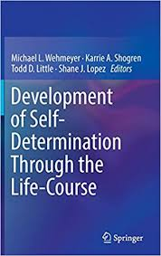
Causal Agency Theory
Causal Agency Theory explains how people become self-determined.
Self-determination is “a dispositional characteristic manifested as acting as the causal agent in one’s life. Self-determined people (i.e., causal agents) act in service to freely chosen goals. Self-determined actions function to enable a person to be the causal agent is his or her life” (Shogren et al., 2015).
One purpose of Causal Agency Theory was to align our work with research in motivation to construct a theory of the development of self-determination.

Slide 33


Misperceptions of Self-Determination
Misperceptions of Self-Determination
Self-determination is control.
Self-determination is independent performance.
Self-determination is just making a choice.
Self-determination is just involving students in planning.

Slide 34
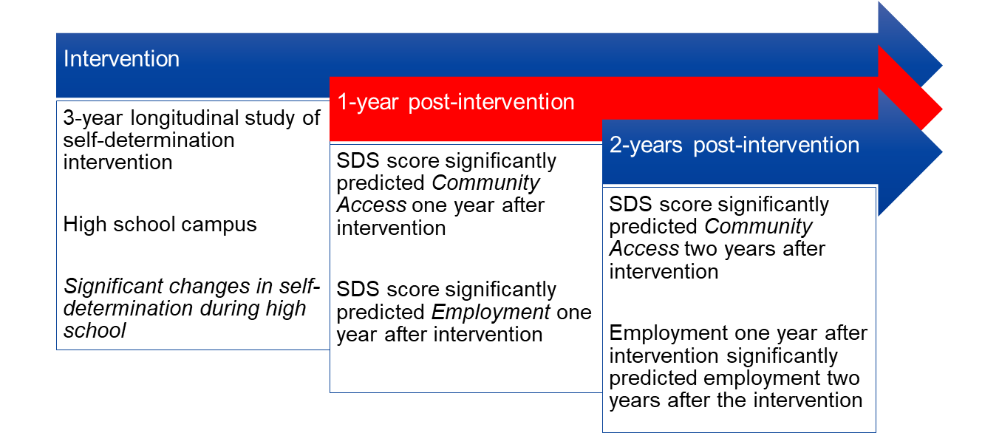
Evidence for the Importance of Self-Determination
Why is Self-Determination Important?
Research has established that:
  students across disability categories can acquire the knowledge and skills that enable them to become more self-determined.
  there is a strong positive relationship between enhanced self-determination and more positive self-reported quality of life and life satisfaction.
  students who are more self-determined:
    achieve academic and transition goals at a higher rate.
    are more involved in the general education curriculum.
    achieve more positive independent living outcomes upon graduation.
    achieve more positive employment outcomes upon graduation.
  promoting self-determination raises teachers’ expectations of students’ performance.
Notes:
More icons available at:

Slide 35
Why is Student Involvement Important?
Students participate in their planning more actively.
Student involvement promotes self-determination (and students who are more self-determined are more likely to be involved in their educational planning).
Student involvement results in enhanced transition knowledge.
Students who are involved in their transition planning feel more empowered.
Higher Levels of Self-Determination
More Active Student Involvement

Slide 36
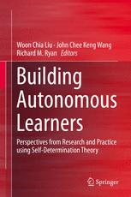
Autonomy-Supportive Classrooms
Research in motivation has validated the importance of autonomy-supportive classrooms and described the characteristics of autonomy-supportive teaching practices, including:
  Communicating frequently to present expectations and acknowledge students’ feelings.
  Offering more choices and removing controlling events in learning.
  Allowing students to participate actively.
  Providing positive and informational feedback.
  Providing structured guidance.

Slide 37
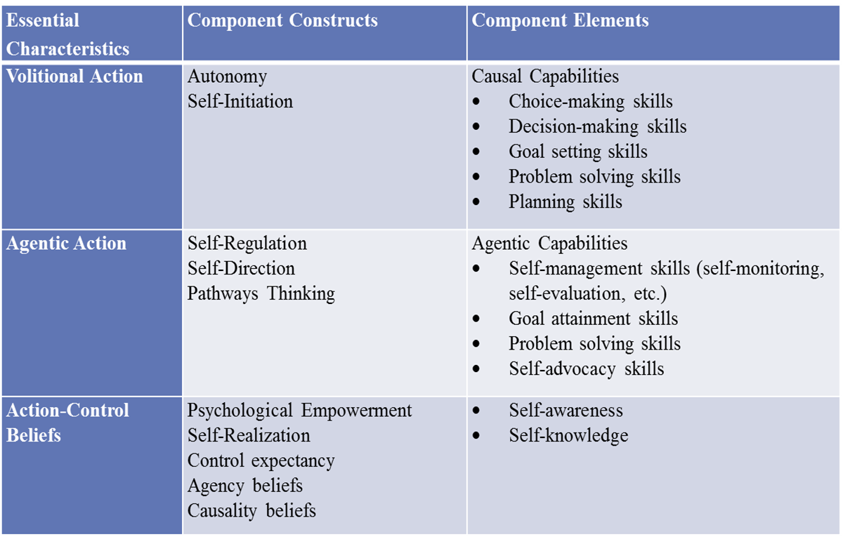
Promoting Self-Determination
Schoolwide Efforts to Promote Self-Determination
Instruction to promote component elements of self-determined behavior:
  Choice-making skills
  Decision-making skills
  Goal setting and attainment skills
  Planning skills
  Problem-solving skills
  Self-regulation and self-management skills
  Self-advocacy skills
  Self-Awareness and self-knowledge
Opportunities to act as a causal agent in one’s life.
Supports to enable success.
Notes:
More icons available at:

Slide 38

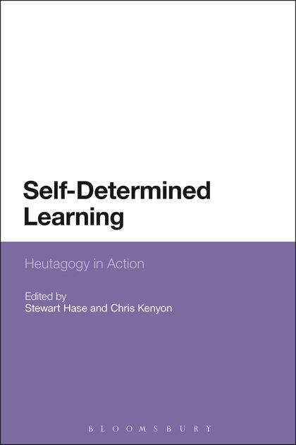
In Self-Determined Learning:
Teachers teach students to teach themselves.
Students learn how to set and achieve goals and make plans.
Teachers relinquish ownership for learning to the student by:
  Creating learning communities and using teaching methods that emphasize students’ curiosity and experiences;
  Creating learning communities that are autonomy-supportive;
  Ensuring that learning is tied to activities that are intrinsically motivating or lead to the attainment of goals that are valued and based upon student preferences, interests, values.
Teachers provide competence supports by emphasizing mastery experiences, using assessment (both teacher-directed and student-directed) to provide supportive feedback, and aligning instruction with students’ strengths and abilities.
Teachers provide relatedness supports by providing choice opportunities, supporting volition, and emphasizing the goal process and not just goal outcomes.
Students take initiative in learning because learning is meaningful and of personal value to them.
Students act volitionally because they are provided choices that are meaningful, meaningfully different, and autonomy-supportive.

Slide 39
Intervention and Measurement
  The Self-Determined Learning Model of Instruction
    A teaching model design to support teachers to teach students to self-regulate goal setting and attainment…to enable them to engage in causal action.
    Students are supported to learn to self-regulate problem solving to set relevant goals, create an action plan to achieve the goal, track their progress toward their goal, and adjust their action plan or goal as necessary.
    Strong evidence base with students with disabilities.
  The Self-Determination Inventory System
    Self-Determination Inventory: Self-Report Version
    Self-Determination Inventory: Adult-Report Version
    Measures volitional action, causal action, action-control beliefs.

Slide 40
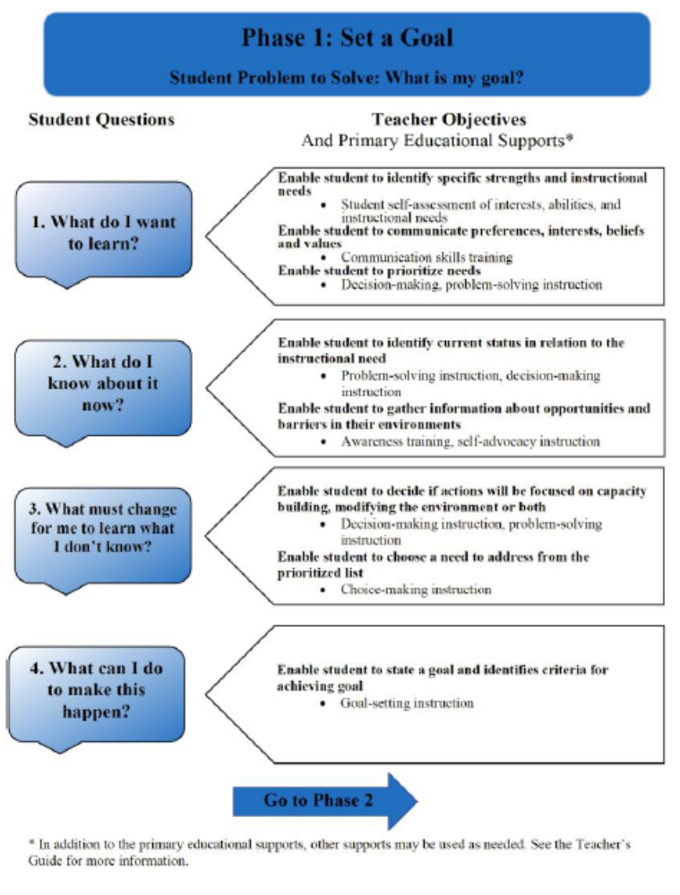

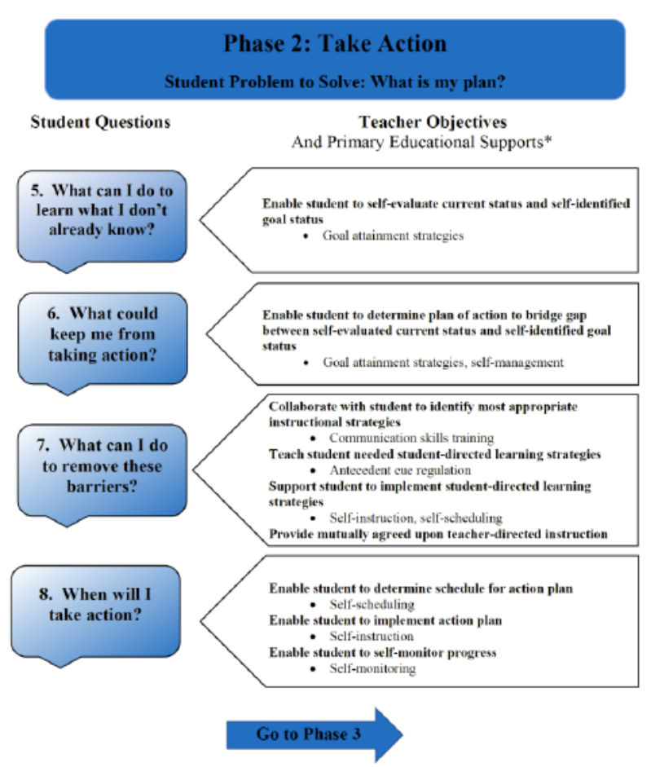
Self-Determined Learning Model of Instruction

Slide 41
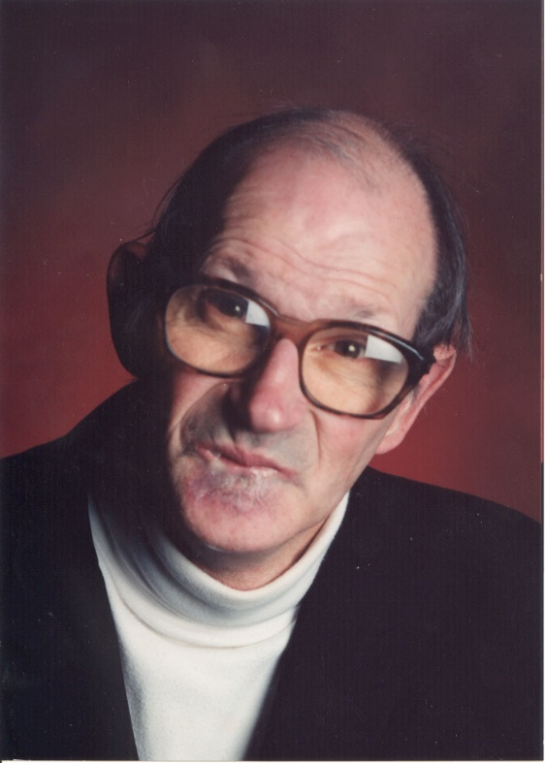
Why is Self-Determination Important?
“When I moved to New Bedford, I wanted to open a checking account. I went over to the bank and gave the $10 to open the account and asked them if there would be a problem. They said no. But, when I went back a couple of days later, they said they couldn’t understand my signature.”

Slide 42
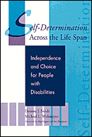
Why is Self-Determination Important?
“I thought about this and realized that I had a checking account before I moved, and that had worked fine. The next morning, I put on a suit and tie and went down to the main branch. I asked to see the bank president. They told me he was in a meeting. I told them I would wait.”

Slide 43
Why is Self-Determination Important?
“I waited for about 2 minutes and he came out. He brought me into a room and asked me what the problem was. I told him. I also brought my canceled checks and showed him that I had an account before. He apologized and I got my checking account.
That is why self-determination is important to me.”
Raymond Gagne

Slide 44
http://wehmeyer.pbworks.com

