Slide 1

Building the Bridge to 21st Century Transitions: Methods, Materials, and Strategies to Promote Self-Determination
Michael L. Wehmeyer, Ph.D.
Ross and Marianna Beach Distinguished Professor in Special Education
Chair, Department of Special Education
Senior Scientist and Director, Beach Center on Disability
University of Kansas

Slide 2
http://wehmeyer.pbworks.com

Slide 3
Assessment
The Arc’s Self-Determination Scale
Self-Determination Inventory: Student Report (SDI:SR)
Self-Determination Inventory: Parent/Teacher Report (SDI:PTR)

Slide 4
The Arc’s Self-Determination Scale
Measures General Self-Determination and Domains
  Autonomy
    Independence
      Routine personal care and family oriented functions;
      Interaction with the environment;
    Acting on the basis of preferences, beliefs, interests and abilities
      Recreational and leisure time
      Community involvement and interaction
      Post-school directions
      Personal expression
  Self-Regulation
      Interpersonal cognitive problem solving
      Goal setting and task performance

Slide 5
The Arc’s Self-Determination Scale
Psychological Empowerment
  Locus of control
  Self-efficacy and outcome expectancy
Self-Realization
  Self-awareness
  Self-knowledge
Designed for group or individual administration;
Can be administered orally if needed;
Results in general and subscale scores;
Field-tested with 500 students with cognitive disabilities

Slide 6
The Arc’s Self-Determination Scale
  Scoring steps on back of protocol, yields raw scores for domain and subdomain areas as well as total
  Raw scores converted to percentile scores for comparison with sample norms and percent positive for each domain
  Graphs completed to enable interpretation
  Not prescriptive or diagnostic, intended for use as tool to provide direction for discussion about self-determination and transition goals;
  Levels of scoring;
    complete scale, don’t score;
    complete scale, score only percent positive;
    complete scale, score all components;
  Available at http://education.ou.edu/zarrow

Slide 7
Self-Determination Inventory: Student Report (SDI:SR)
The SDI:SR asks students questions about their ability to be self-determined; that is, to make choices, set and go after goals, and make decisions.
21 items (takes approximately 10 minutes to finish)
Validated for people aged 13 to 22
Online with accessibility features:
  In-text word definitions
  Audio playback
  Mobile/tablet compatibility
  Average grade reading level: 2.8
  Slider scale

Slide 8
Progress bar showing completion status
Gradient when unanswered and then changes color when answered
In-text definitions for challenging words
Checkmark indicating when items have been answered
Play button for audio

Slide 9
Self-Determination Inventory: Parent/Teacher Report (SDI:PTR)
The Self-Determination Inventory: Parent/Teacher Report (SDI:PTR) measures a teacher’s or parent/family member’s perception of a young person’s self-determination.
Mirrors the 21 items in the SDI:SR (takes only 10 minutes to finish)
Online with accessibility features:
  Audio playback
  Mobile/tablet compatibility
  Slider scale
SDI Student Report item
I have what it takes to reach my goals.
SDI Parent/Teacher Report item
This student has what it takes to reach his/her goals.

Slide 10
Printer-friendly
Overall self-determination
(average of item scores)
Average scores of items within each essential characteristic of self-determination
In-text definitions of essential characteristics

Slide 11
Self-Determination Inventory: Student & Parent/Teacher Report Guide

Slide 12
Promoting Student Involvement in Planning
Whose Future is it Anyway?
Whose Future is it?
The Self-Directed IEP

Slide 13


Whose Future is it Anyway?

Slide 14
Whose Future is it Anyway?
Whose Future
493 middle, high school, and transition students across multiple disabilities
Outcomes
Implications
Causal, positive effect of Whose Future on student self-determination
Improved self-determination and transition knowledge and skills
Wehmeyer, M.L., Palmer, S.B., Lee, Y., Williams-Diehm, K., & Shogren, K.A. (2011). A randomized-trial evaluation of the effect of Whose Future is it Anyway? on self-determination. Career Development for Exceptional Individuals, 34(1), 45-56.

Slide 15

Whose Future is it Anyway?
What is Student-Directed?
The student is the primary audience for the materials and is responsible for moving through the materials;
The key to student-directed is that the student retains control over his or her learning process, even when others (teachers, parents, peers) participate.
Not the same as independent performance. That is, students will vary a great deal in the degree to which they can work through the materials independently. Factors which influence this include:
  Reading or writing skills;
  Confidence in working alone or in small groups;
  Practice with self-directed instruction.
Student-directed learning involves the utilization of strategies to enable students to self-direct learning:
  Self-monitoring
  Self-instruction
  Self-evaluation

Slide 16
Whose Future is it Anyway?
Student-directed transition planning process.
Designed to enable students to take a greater role in their transition planning process.
36 sessions, at approximately 1 hour per session;
Written at 4th grade reading level;
Includes a Coach’s Guide
Six primary content areas
  Getting to know YOU;
  Making Decisions;
  How to get what you need, Sec. 101;
  Goals, Objectives and the Future;
  Communicatin’(Or I thought you said he said she said?);
  Thank you, Honorable Chairperson.

Slide 17
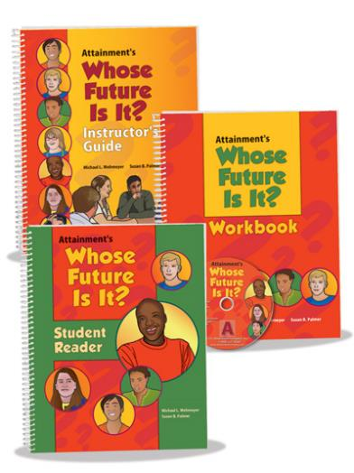

Whose Future is it?
15 chapters divided into three sections
  Section One: Getting to Know Your IEP
  Section Two: Decisions and Goals
  Section Three: Your IEP Meeting
Student Reader
Student Workbook
Instructor’s Guide

Slide 18
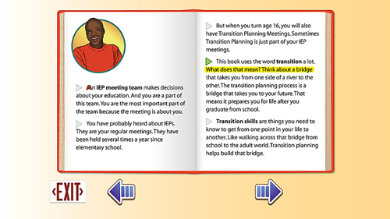

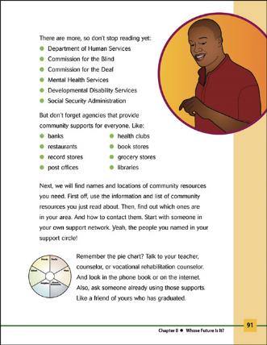
Whose Future is it?

Slide 19

Whose Future is it?
Instructor’s Guide
Interplay between Student Reader and Workbook
Vocabulary guide
Overview of sections and activities
Accommodation ideas
CD – printable and electronic materials

Slide 20
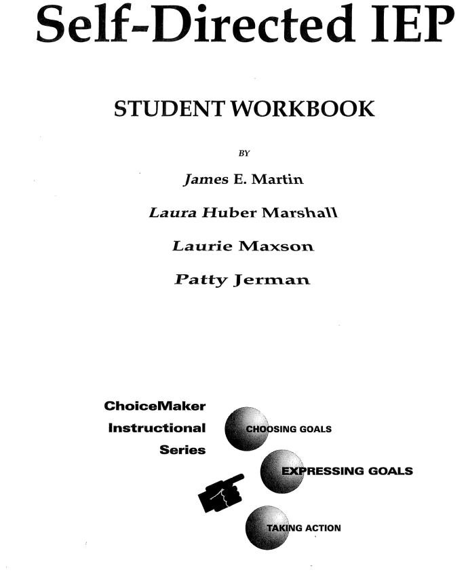
Self-Directed IEP
Part of the Choice-Maker Self-Determination Curriculum
The Self-Directed IEP teaches students to become active participants in their IEP meetings and to lead their IEP meeting, with coaching being provided as needed by the teacher who taught the lessons. The Self-Directed IEP contains four instructional tools:
  SDIEP in Action Video
  SDIEP Video
  Teacher’s Manual
  Student Workbook

Slide 21
Self-Directed IEP
Self-Directed IEP
130 Secondary age students randomly assigned to treatment or control group
Outcomes
Implications
Increased percent of time students talked, started, and led meetings.
Improved self-determination and student involvement.
Martin, J.E., Van Dycke, J.L., Christensen, W.R., Greene, B.A., Gardner, J.E., & Lovett, D.L. (2006). Increasing student participation in IEP meetings: Establishing the Self-Directed IEP as an evidenced-based practice. Exceptional Children, 72(3), 299-316.

Slide 22
Self-Directed IEP
Self-Directed IEP
Teaches students 11 steps in running their IEP meeting
Begin the meeting by stating the purpose.
Introduce everyone.
Review past goals and performance.
Ask for others’ feedback.
State your school and transition goals.
Ask questions if you do not understand.
Deal with differences in opinion.
State what support you will need.
Summarize your goals.
Close the meeting by thanking everyone.
Work on IEP goals all year.

Slide 23

Both Available Online for Free
http://www.ou.edu/education/centers-and-partnerships/zarrow.html
http://www.ngsd.org

Slide 24
Promoting Self-Determination
Evidence-based practices

Slide 25
Component Elements of Self-Determined Behavior
Choice-making
Decision-making
Problem-solving
Goal setting and attainment
Self-advocacy
Self-observation, evaluation and reinforcement
Internal locus of control
Autonomous motivation
Self-awareness
Self-knowledge

Slide 26
The Emergence of Self-Determination
Enhanced capacity as a result of:
  attainment of developmental milestones;
  acquisition of component elements.
Opportunity to assume control as a result of:
  environments that support control and choice;
  frequent experiences of choice and control.
Supports and accommodations.

Slide 27
Principal of Partial Participation
Even if a person cannot acquire all the skills that are required to function independently in an environment, he or she should have access to that environment and enabled to learn those skills that they are able to acquire.

Slide 28

Choice Making
Making a choice =
  Indicating a preference
  Between two or more options
  “Ability is of little account
  without opportunity”
  --Napoleon Bonaparte

Slide 29
Issues in Choice Making for Students with Neurodevelopmental Disabilities
Some students with neurodevelopmental disabilities have fewer opportunities to learn about preferences based on personal experiences than their peers.
Students with more neurodevelopmental disabilities with communication impairments may not be able to express preferences in traditional ways.
    Problem behavior as an expression of preference.
Educators and family members have not conducted a systematic analysis of preferences.
Students with intensive support needs may need to learn how to make a choice.
  May have learned “other” means of expressing preferences or making choices.

Slide 30
Choice Making
Particularly important for childhood/early elementary. Provides opportunity to teach students they have a voice in their education.
Including a choice opportunity within behavioral interventions has been shown to improve outcomes.
People’s preferences change. Just because a student liked something at one time doesn’t mean he or she will like it at another time.
    Assess frequently.

Slide 31
Integrating Choices Into Teaching
Incorporating student choice as an early step in the instructional process;
Increasing the number of choices related to a given activity which the student makes;
Increasing the number of domains in which choices are made;
Raising the significance in terms of risk and long-term consequences of the choices which the student makes; and
Clear communication with the student concerning areas of possible choice, and the limits within which choices can be made.

Slide 32
Promoting Problem-Solving
A problem is an activity or task for which a solution is not known or readily apparent.
Three focal points to instruction in problem solving:
  problem identification;
  problem explication and analysis;
  problem resolution.
Should occur within environments that emphasize;
  student’s capacity to solve problems;
  promote open inquiry and exploration
  encourage generalization.

Slide 33
Issues in Problem Solving for Students with Neurodevelopmental Disabilities
Many, if not most, of the types of problems that need to be addressed are social in nature and involve one’s interactions with others.
Any difficulty in understanding social and emotional cues will, in turn, impact a student’s capacity to identify and analyze the problem.
  Most research/practice to promote social/emotional understanding has focused exclusively on social skills, without addressing social problem solving.

Slide 34
Promoting Decision-Making
Most models of decision making incorporate the following steps:
  listing relevant action alternatives;
  identifying possible consequences of those actions
  assessing the probability of each consequence occurring (if the action were undertaken);
  establishing the relative importance (value or utility) of each consequence;
  integrating these values and probabilities to identify the most attractive course of action.

Slide 35
Goal Setting and Attainment
Instructional efforts to promote goal setting and attainment should focus on:
  Goal identification and enunciation
  Developing objectives to meet goals;
  Identifying actions necessary to achieve goals;
  Tracking and following progress on goals.
Participation in educational planning and decision-making as ideal generalization mechanism.

Slide 36
Promoting Self-Advocacy Skills
Skills needed to advocate on one’s own behalf;
Will focus on two common threads;
    how to advocate;
    what to advocate;
Particularly important during secondary education, should be tied directly to educational planning meeting.
How to advocate:
  rights and responsibilities;
  assertiveness vs. aggressiveness;
  communicating effectively (one-on-one, small group)
  negotiation, compromise and persuasion;
  effective listening;
  basic leadership and team skills

Slide 37
Student-Directed Learning
Strategies
Student-directed learning strategies, alternatively referred to as self-regulated learning or self-management strategies, involve teaching students to modify and regulate their own behavior.
Student-mediated (vs. teacher-mediated, peer-mediated or technology-mediated) learning.
Self-instruction, antecedent cue regulation, self-monitoring, self-reinforcement, self-evaluation.

Slide 38

Self-Determined Learning
Model of Instruction (SDLMI)

Slide 39
WHAT IS THE SDLMI?
Teaching model that enables students to use a problem solving, goal-setting strategy to:
  Make choices and decisions
  Develop action plans for academic goals
  Self-monitor and self-evaluate progress toward academic goals
What is my
goal?
What is my
plan?
What have I
learned?
Phase 1:
Set a Goal
Phase 2:
Take Action
Phase 3:
Adjust Goal or Plan
Notes:
The SDLMI is a teaching model in that they guide teachers to enable students to become more effective at initiating and self-regulating In their own actions toward goal setting and attainment of academic goals.
The SDLMI is intended to be used by teachers across a variety of academic content areas to support positive student outcomes (e.g., academic achievement, enhanced self-determination).
The SDLMI has three distinct phases that are each associated with a question the student must solve. The questions in Phase 1 guide the student in setting a goal or answering the question “What is my goal?” The questions in Phase 2 support the student to develop an action plan to achieve the goal they set in Phase 1 and to identify a self-monitoring process to track their progress toward reaching that goal. Therefore, the question students answer in Phase 2 is “What is my plan?” The questions in Phase 3 support the student to evaluate his or her progress toward the goal, and answer the question “What have I learned?”

Slide 40
IMPLEMENTING THE
SDLMI
How much time does implementing the SDLMI take?
  Individualized based on the strengths and support needs of the student
What kinds of goals do students set?
  Goals related to:
    Academics
    Vocational skills
    Transition
    Social Interaction
How do teachers integrate the SDLMI with existing instruction?
  Students often work toward goals throughout the day as opportunities arise
  Teachers support students, but students self-direct the process.

Slide 41
HOW TO USE THE SDLMI
Teachers can use the SDLMI in a variety of settings with a variety of goals:
  Academic goals linked to general education curricula
  Employment goals at job sites
  Independent living goals in the community
Guided by Student Questions as teachers meet Teacher Objectives and uses Educational Supports
The amount of time it takes depends on the supports each student needs
Teacher Objectives
Educational
Supports
Student Questions

Slide 42
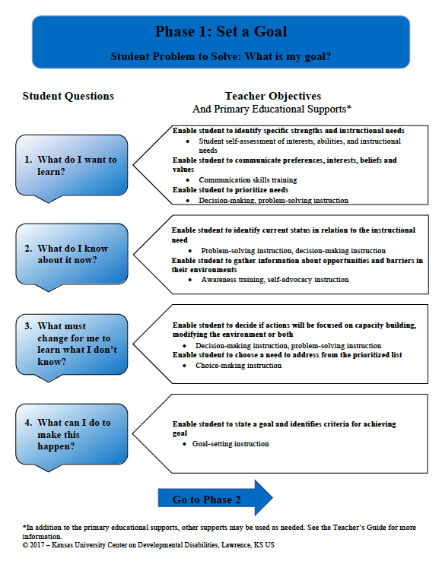
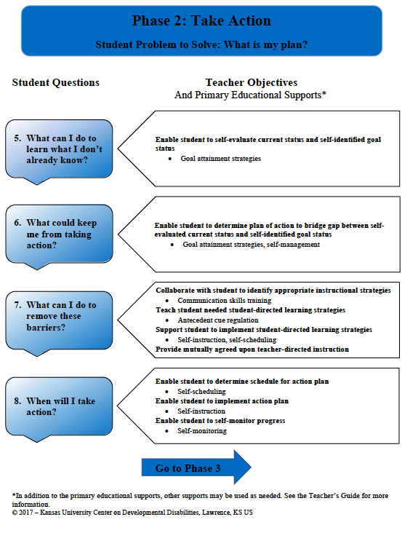
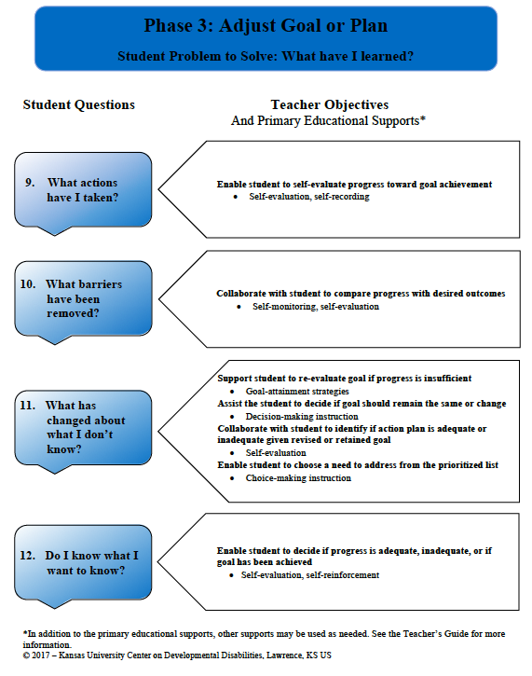
Phases of the SDLMI

Slide 43
ROLES IN SDLMI
Facilitator
Instructor
Advocate
Teacher
Self-Directed Learner
Active Learner
Self-Advocate
Student
Partner to identify and
develop resources

Slide 44
Phase 1: Set a Goal

Slide 45
Phase 1 Overview
Student problem to solve: What is my goal?
4 Student Questions
8 Teacher Objectives
Embedded Educational Supports

Slide 46
Phase 1 Student Questions
Teacher Objectives
Educational Supports
Student Questions
Phrased in “first-person voice”
Follow a sequence so that the student sets a goal by the end of Phase 1
Variability in the amount of time it might take to answer each question because it is an individualized process
Phase 1 Student Questions
1. What do I want to learn?
2. What do I know about it now?
3. What must change for me to learn what I don't know?
4. What can I do to make this happen?

Slide 47
Phase 1 Teacher Objectives
Teacher Objectives
Educational Supports
Student Questions
Specific Teacher Objectives are linked to each Student Question
Serve as a “Road Map” for teacher to enable student to answer Student Questions to ultimately set a goal by the end of the Phase
Teachers should meet each objective before the student starts the next Student Question
Student Question 1: What do I want to learn?
Enable student to identify specific strengths and instructional needs
Enable student prioritize needs
Enable student to communicate preferences, interests, beliefs and values

Slide 48
Educational Supports
Teacher Objectives
Educational Supports
Student Questions
Provide a means for educators to use individualized supports to enable students to begin to teach themselves.
Enable students to:
  Successfully self-direct their learning
  Modify and regulate their own behavior

Slide 49
Phase 2: Take Action

Slide 50
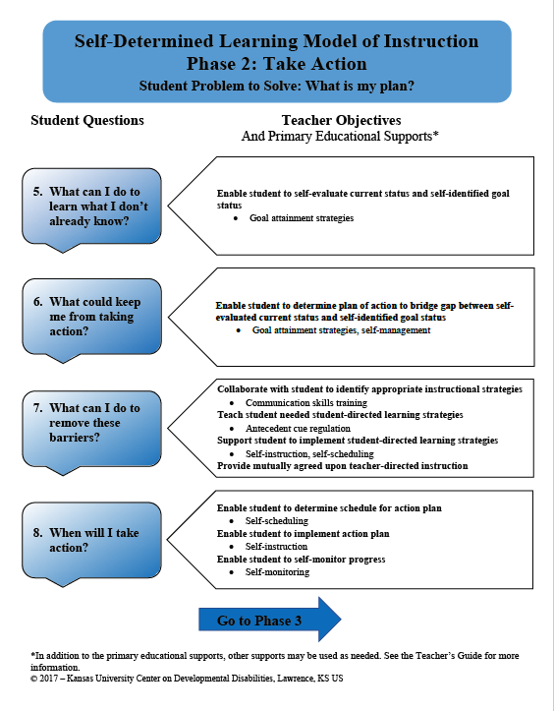
Phase 2 Overview
Student problem to solve: What is my plan?
4 Student Questions
8 Teacher Objectives
Embedded Educational Supports

Slide 51
Phase 2 Student Questions
Teacher Objectives
Educational Supports
Student Questions
Phrased in “first-person voice”
Follow a sequence so that the student creates an action plan and a self-monitoring plan by the end of Phase 2
Variability in the amount of time it might take to answer each question because it is an individualized process
Phase 2 Student Questions
5. What can I do to learn what I don't already know?
6. What could keep me from taking action?
7. What can I do to remove these barriers?
8. When will I take action?

Slide 52
Phase 2 Teacher Objectives
Teacher Objectives
Educational Supports
Student Questions
Specific Teacher Objectives are linked to each Student Question
Serve as a “Road Map” for teacher to enable student to answer Student Questions to create an action plan and a self-monitoring plan by end of Phase.
Teachers should meet each objective before the student starts the next Student Question
Student Question 5: What can I do to learn what I don’t already know?
Enable student to self-evaluate current status and self-identified goal status

Slide 53
Phase 3: Adjust Goal or Plan

Slide 54
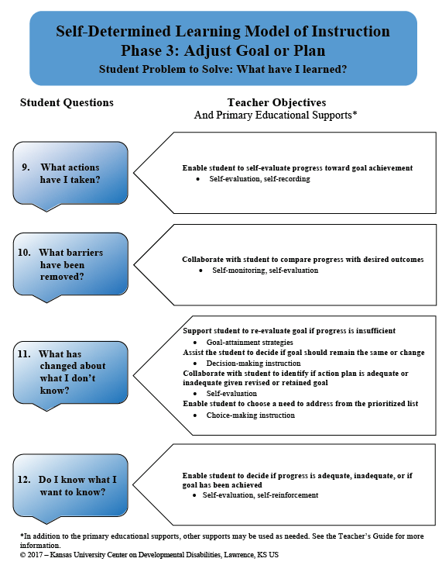
Phase 3 Overview
Student problem to solve: What have I learned?
4 Student Questions
8 Teacher Objectives
Embedded Educational Supports

Slide 55
Phase 3 Student Questions
Teacher Objectives
Educational Supports
Student Questions
Phrased in “first-person voice”
Follow a sequence so that the student makes a decision to revise plan or set a new goal.
Variability in the amount of time it might take to answer each question because it is an individualized process
Phase 3 Student Questions
9. What actions have I taken?
10. What barriers have been removed?
11. What has changed about what I don’t know?
12. Do I know what I want to know?

Slide 56
Phase 3 Teacher Objectives
Teacher Objectives
Educational Supports
Student Questions
Specific Teacher Objectives are linked to each Student Question
Serve as a “Road Map” for teacher to enable student to answer Student Questions to revise action plan or goal if needed.
Teachers should meet each objective before the student starts the next Student Question
Student Question 10: What barriers have been removed?
Collaborate with student to compare progress with desired outcomes

Slide 57
“I know I’m going to reach my goal because I’m trying.”
“I made progress on my goal because I tried to.”
“I would do this again. It helped me.”
ROLES
IN SDLMI

Slide 58
www.self-determination.org

